Slide 1
Allstate Insurance Claims Severity Prediction
Group 5
Kyungmook Lim
Hayoung Kim
Hyung Joon Choi
Younhyuk Cho

Slide 2
Data Explanation
Currently On-going Kaggle competition:
“How severe is an insurance claim”
Consists of 188,318 insurance claims from the Allstate Insurance Company
Used only 20,000 observations out of 188,318 to reduce computational cost (16,000 for training set, 4,000 for testing set)
Predictors (anonymous due to the privacy issue)
116 categorical variables
(each with different number of levels from 2 to 230)
14 continuous variables
Response (adjusted to disguise real value)
Loss amount

Slide 3
Strategies
Models to use:
Decision Tree, Random Forest, PCA, and XGBoosting
Strategies for issues:
Formulate strategy on handling large number of variables
→ Applying PCA and XGBoosting to categorical variables
Formulate strategy on handling categorical variables with large number of levels
→ Random Forest can’t be quite used

Slide 4
Response Averaging
Fitting models and obtaining predictions are challenging with categorical variables with large numbers of levels.
As a remedial measure, categorical variables with ≥32 levels are replaced by the average of loss amount in the training set corresponding to that categorical value.
Observed 5 such categorical variables
Name | Number of Categories
Cat109 | 60
Cat110 | 97
Cat112 | 51
Cat113 | 52
Cat116 | 230

Slide 5

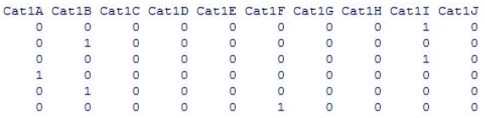
Design Matrix
Established design matrix to apply PCA to categorical variables
Example:
→

Slide 6
Correlation Coefficients
Correlation matrix between 14 continuous variables
The correlation coefficients ≥0.7 are highlighted
 | cont1 | cont2 | cont3 | cont4 | cont5 | cont6 | cont7 | cont8 | cont9 | cont10 | cont11 | cont12 | cont13 | cont14
cont1 | 1.00 | -0.09 | -0.45 | 0.37 | -0.03 | 0.76 | 0.36 | 0.36 | 0.93 | 0.81 | 0.59 | 0.61 | 0.54 | 0.06
cont2 | -0.09 | 1.00 | 0.45 | 0.03 | 0.18 | 0.02 | 0.06 | 0.14 | -0.03 | 0.06 | 0.13 | 0.11 | 0.02 | -0.05
cont3 | -0.45 | 0.45 | 1.00 | -0.35 | 0.09 | -0.35 | 0.10 | -0.19 | -0.42 | -0.32 | 0.03 | 0.01 | -0.42 | -0.04
cont4 | 0.37 | 0.03 | -0.35 | 1.00 | 0.16 | 0.22 | -0.12 | 0.52 | 0.33 | 0.28 | 0.12 | 0.13 | 0.18 | 0.02
cont5 | -0.03 | 0.18 | 0.09 | 0.16 | 1.00 | -0.15 | -0.25 | 0.01 | -0.09 | -0.07 | -0.16 | -0.16 | -0.08 | -0.01
cont6 | 0.76 | 0.02 | -0.35 | 0.22 | -0.15 | 1.00 | 0.66 | 0.44 | 0.79 | 0.88 | 0.77 | 0.78 | 0.82 | 0.04
cont7 | 0.36 | 0.06 | 0.10 | -0.12 | -0.25 | 0.66 | 1.00 | 0.15 | 0.38 | 0.49 | 0.75 | 0.74 | 0.30 | 0.01
cont8 | 0.36 | 0.14 | -0.19 | 0.52 | 0.01 | 0.44 | 0.15 | 1.00 | 0.45 | 0.33 | 0.30 | 0.31 | 0.47 | 0.05
cont9 | 0.93 | -0.03 | -0.42 | 0.33 | -0.09 | 0.79 | 0.38 | 0.45 | 1.00 | 0.78 | 0.60 | 0.62 | 0.64 | 0.07
cont10 | 0.81 | 0.06 | -0.32 | 0.28 | -0.07 | 0.88 | 0.49 | 0.33 | 0.78 | 1.00 | 0.70 | 0.72 | 0.71 | 0.04
cont11 | 0.59 | 0.13 | 0.03 | 0.12 | -0.16 | 0.77 | 0.75 | 0.30 | 0.60 | 0.70 | 1.00 | 0.99 | 0.47 | 0.04
cont12 | 0.61 | 0.11 | 0.01 | 0.13 | -0.16 | 0.78 | 0.74 | 0.31 | 0.62 | 0.72 | 0.99 | 1.00 | 0.48 | 0.04
cont13 | 0.54 | 0.02 | -0.42 | 0.18 | -0.08 | 0.82 | 0.30 | 0.47 | 0.64 | 0.71 | 0.47 | 0.48 | 1.00 | 0.05
cont14 | 0.06 | -0.05 | -0.04 | 0.02 | -0.01 | 0.04 | 0.01 | 0.05 | 0.07 | 0.04 | 0.04 | 0.04 | 0.05 | 1.00
 | cont1 | cont2 | cont3 | cont4 | cont5 | cont6 | cont7 | cont8 | cont9 | cont10 | cont11 | cont12 | cont13 | cont14
cont1 | 1.00 | -0.11 | -0.46 | 0.38 | -0.04 | 0.77 | 0.38 | 0.38 | 0.93 | 0.82 | 0.61 | 0.63 | 0.55 | 0.07
cont2 | -0.11 | 1.00 | 0.48 | 0.03 | 0.21 | -0.01 | 0.03 | 0.12 | -0.06 | 0.04 | 0.10 | 0.09 | 0.00 | -0.03
cont3 | -0.46 | 0.48 | 1.00 | -0.34 | 0.10 | -0.35 | 0.08 | -0.19 | -0.43 | -0.34 | 0.01 | -0.01 | -0.42 | -0.03
cont4 | 0.38 | 0.03 | -0.34 | 1.00 | 0.16 | 0.22 | -0.12 | 0.53 | 0.35 | 0.30 | 0.13 | 0.14 | 0.19 | 0.04
cont5 | -0.04 | 0.21 | 0.10 | 0.16 | 1.00 | -0.16 | -0.26 | -0.01 | -0.10 | -0.07 | -0.16 | -0.16 | -0.10 | -0.01
cont6 | 0.77 | -0.01 | -0.35 | 0.22 | -0.16 | 1.00 | 0.68 | 0.45 | 0.80 | 0.89 | 0.78 | 0.80 | 0.82 | 0.04
cont7 | 0.38 | 0.03 | 0.08 | -0.12 | -0.26 | 0.68 | 1.00 | 0.14 | 0.40 | 0.50 | 0.74 | 0.74 | 0.32 | 0.02
cont8 | 0.38 | 0.12 | -0.19 | 0.53 | -0.01 | 0.45 | 0.14 | 1.00 | 0.47 | 0.36 | 0.32 | 0.34 | 0.49 | 0.05
cont9 | 0.93 | -0.06 | -0.43 | 0.35 | -0.10 | 0.80 | 0.40 | 0.47 | 1.00 | 0.80 | 0.63 | 0.65 | 0.65 | 0.08
cont10 | 0.82 | 0.04 | -0.34 | 0.30 | -0.07 | 0.89 | 0.50 | 0.36 | 0.80 | 1.00 | 0.70 | 0.72 | 0.72 | 0.05
cont11 | 0.61 | 0.10 | 0.01 | 0.13 | -0.16 | 0.78 | 0.74 | 0.32 | 0.63 | 0.70 | 1.00 | 0.99 | 0.49 | 0.06
cont12 | 0.63 | 0.09 | -0.01 | 0.14 | -0.16 | 0.80 | 0.74 | 0.34 | 0.65 | 0.72 | 0.99 | 1.00 | 0.50 | 0.06
cont13 | 0.55 | 0.00 | -0.42 | 0.19 | -0.10 | 0.82 | 0.32 | 0.49 | 0.65 | 0.72 | 0.49 | 0.50 | 1.00 | 0.03
cont14 | 0.07 | -0.03 | -0.03 | 0.04 | -0.01 | 0.04 | 0.02 | 0.05 | 0.08 | 0.05 | 0.06 | 0.06 | 0.03 | 1.00
Train Set
Test Set

Slide 7
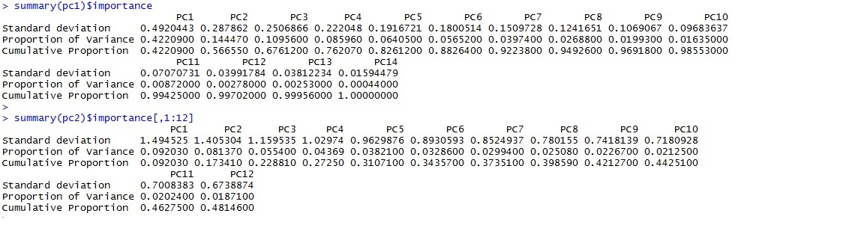
PCA Result
Continuous variables
→7 PCs explain 92% of the variation
Categorical variables
→8 PCs explain 40% of the variation
(Using 8 PCs for categorical variables gives the best result)

Slide 8
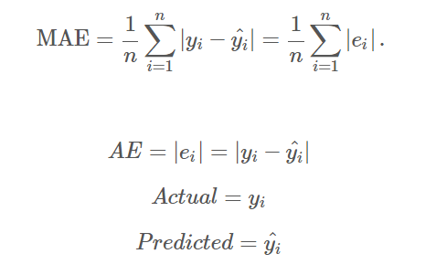
Evaluation Method
Mean Absolute Error (MAE) between the predicted loss and the actual loss
(Used by Allstate Insurance company on Kaggle to evaluate the performance)

Slide 9
Model Comparison
Model | MAE
Regression Tree | 1393.275
Regression Tree + PCA | 1471.891
Random Forest + PCA | 1344.020
XGBoosting + PCA | 1310.501
(The lower, the better)

Slide 10
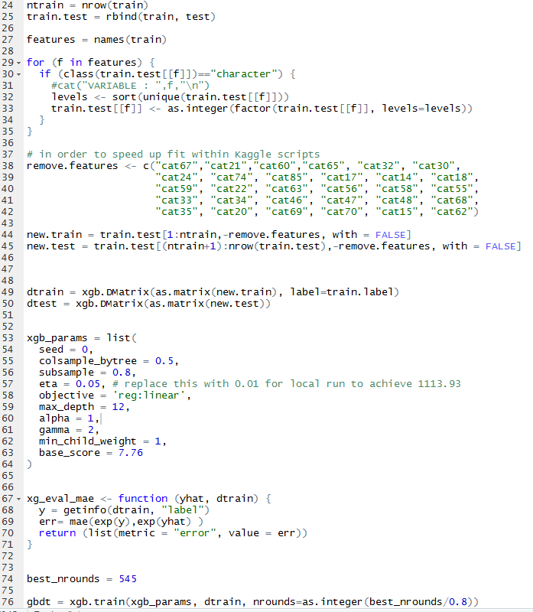
Popular method among Kaggle competitors: “XGB starter ported to R”
Notes:
Starter

Slide 11
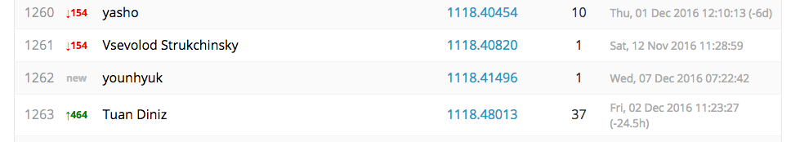
Example Submission Result
XGBoosting with full data set
Mean Absolute Error: 1118.41496 (All zero benchmark: 3019)
Ranking on Kaggle: 1262 (as of Wed. 7)
Winning competitor’s score: 1097.27632

Slide 12
Thank you
Q & A

